Slide 1
Embodied Evolutionary Digital Models
Randy Olson

Slide 2
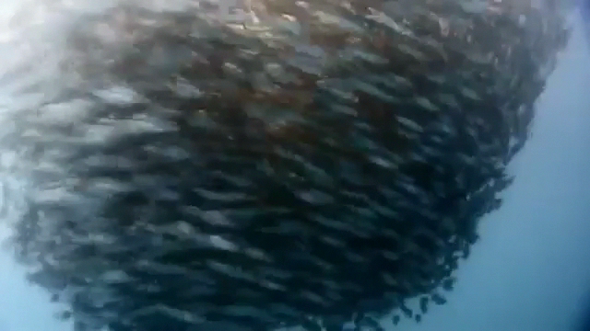

Slide 3
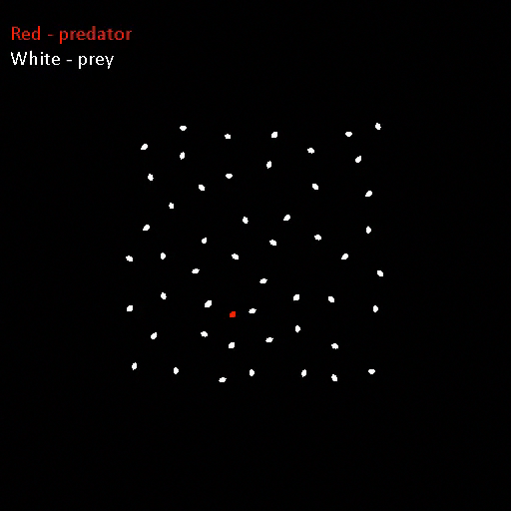
Generation 1
Notes:
White dots = prey, red dots = predators.
We model individual organisms with a visual system, an artificial brain that controls it, and muscles that make them move.
Play video.

Slide 4
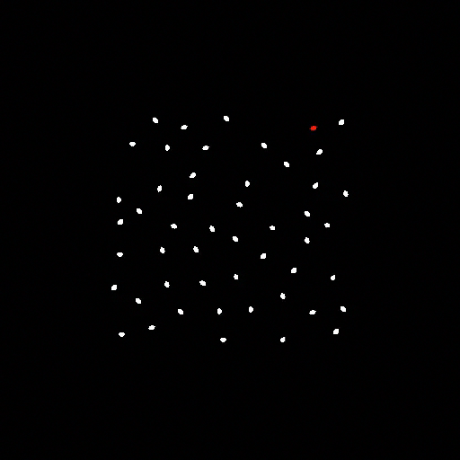
Generation 100
Notes:
We evolve the behavior of these organisms, where prey that survive longer and predators that consume more prey produce more offspring. So as time goes on, we see prey evolve better defensive strategies against the predator, and predators evolve more efficient hunting strategies

Slide 5
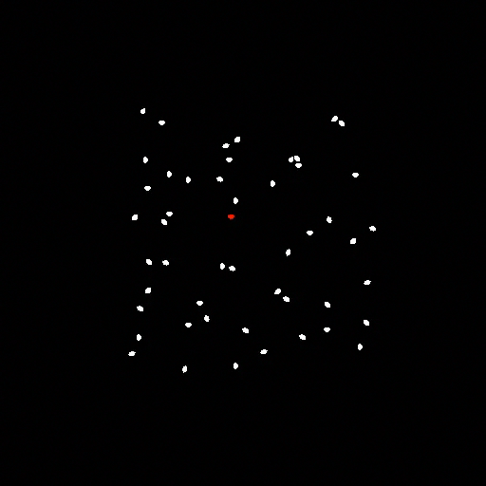
Generation 200
Notes:
The nice part about these evolutionary digital models is that we can use them to rapidly explore these hypotheses about the evolution of swarming behavior.

Slide 6


